Slide 1

Fantasy cricket Team

Slide 2
Introduction---
It is an online game in which a virtual team of real cricket players is created and points are scored depending on how those players perform in real-life matches. To win a tournament, players must work towards attaining the maximum points and the highest rank on the leaderboard.

Slide 3
Understanding the player's performance.
Knowing the pitch performance
Check weather conditions
Find out which players are playing
Calculate the cost
Keep an eye on players who are providing bonus points
Master the art of balance

Slide 4

Problem Statement :
Help user to select players seamlessly, without looking at other websites or app where everyone knows the player and match details.

Slide 5
Overview
Fantasy cricket has been conceived as a game of skill for cricket enthusiasts. But in its current form however fantasy cricket falls short of expectation on few fronts.
It assumes complete knowledge
Access to complete information essential to creating a strong team
Doesn’t follow the natural decision-making process of an individual who would want to create the game.
People who do end up playing put in a lot of time researching other sites etc and this is something that we can help the players circumvent by allowing them access to that information.

Slide 6
Available Data to Solve the Problem From API Providers
Season: A season is a year timeframe. ie: 2016, 2014–15 etc. Tournaments played between March to September is marked with current year as season name.
Competition: Competition is a tour, or tournament, or trophy cup. A competition contains information matches, teams, player performance, table standings, season, dates, type, category etc.
Round: When a tournament demands group stage matches or a tour contains different format matches (as series), we keep their data as round.

Slide 7

Match: A match makes a connection between teams, competition, round, players and innings.
Inning: Inning hold single match inning data.
Team: A generic sports team, having a name, logo, country and type of team.
Player: A generic sports player.

Slide 8

Analyze the Problem
Types of users
The clear understanding of the targeted audience is the primary thing you need to solve a problem. ie, you should know exactly for whom you are building the product. If you closely look, you can see 4 types of users in a fantasy cricket game.

Slide 9
Users who know cricket and fantasy: They are the current survivors. They know much about cricket and fantasy game system. I am calling them outstanding students.
Users who know cricket and but not fantasy: These sets of users need to know more about the fantasy gaming system, points etc. If we can provide help about these we can make them also outstanding- let's call them first benchers

Slide 10
Users who don't know cricket but know/ like /interested in fantasy: These are the majority category. This set needs more information about the game, players, competitor, the ground details etc to make a decision. They also like to know how others are doing. Aren’t they the middle benchers?
Users who don’t know cricket and fantasy: Don't know/try to know about cricket and fantasy- still, have some interest to play and make money out of it. Lazy to form a good team. They would be happy well if someone creates it and give- typically backbenchers.

Slide 11
Objectives :
If you are new to fantasy cricket then this is how it works
User needs to create a fantasy cricket team
Users can then participate in a contest with this team.
Each player is assigned a credit value. There is an upper limit on the total credit points in a team.
Each player will fall into one of the following categories: batsman, wicket-keeper, bowler, all-rounder
During the match, points are assigned to the players based on their performance & category.
At the end of the match, based on the points, a team with the maximum points that adhere to all the rules will be the winning combination of the best 11 players.

Slide 12
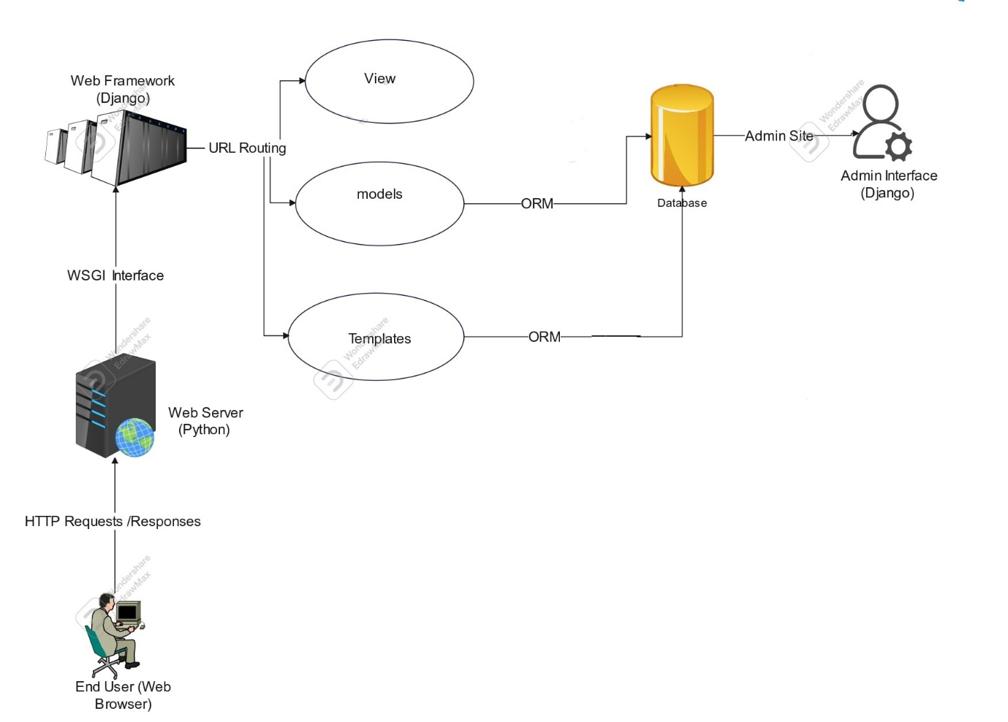
System Architecture :

Slide 13
End User (Web Browser): This is the user who interacts with the website and plays the Fantasy Cricket Game.
Web Server (Python): This is the server-side component that receives HTTP requests from the user's web browser and sends HTTP responses back.
HTTP Requests/Responses: These are the standard HTTP messages used to communicate between the user's web browser and the web server.

Slide 14
WSGI Interface: This is a standard interface between the web server and the web framework, allowing the web server to communicate with the Django
application.
Web Framework (Django): This is a Python web framework that provides the infrastructure for building web applications, including URL routing, views,
models, and templates

Slide 15
URL Routing: This maps incoming URLs to views that generate HTTP responses.
Views: These are Python functions that handle incoming HTTP requests and generate HTTP responses.
Models: These are Python classes that define the data models used by the web application, and provide an Object-Relational Mapping (ORM) layer to
interface with the database.
Templates: These are HTML files that define the structure and layout of the web pages generated by the views

Slide 16
ORM: This is the Object-Relational Mapping layer that provides a Pythonic interface to the database, allowing the application to interact with the
database using Python objects instead of raw SQL.
Database (Python): This is the backend data storage for the web application, implemented in Python, which can be a SQL or NoSQL database
depending on the project's requirements.
Admin Site: This is a built-in Django feature that provides a web-based interface for managing the data in the application's database, typically
accessed only by privileged users.
Admin Interface (Django): This is the web-based interface for managing the data in the application's database, accessed through the Admin Site. It is
typically generated automatically by Django based on the models defined in the application.

Slide 17


